Slide 1
Quantifying Literary Style
Grant Nelson
June 3, 2016
General Assembly

Slide 2
Introduction
Style is a universally recognized aspect of literature, but often vaguely defined
To what extent can style be quantified and reliably detected in an author’s works?
Given a chunk of text, predict which author wrote it
Four contemporaneous authors from the 1920s and ‘30s:
William Faulkner
F. Scott Fitzgerald
Earnest Hemingway
John Steinbeck

Slide 3
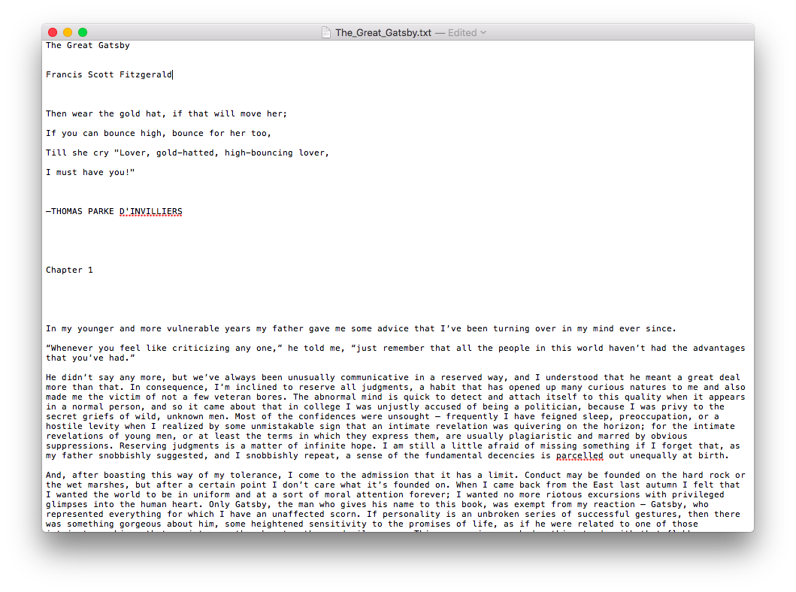
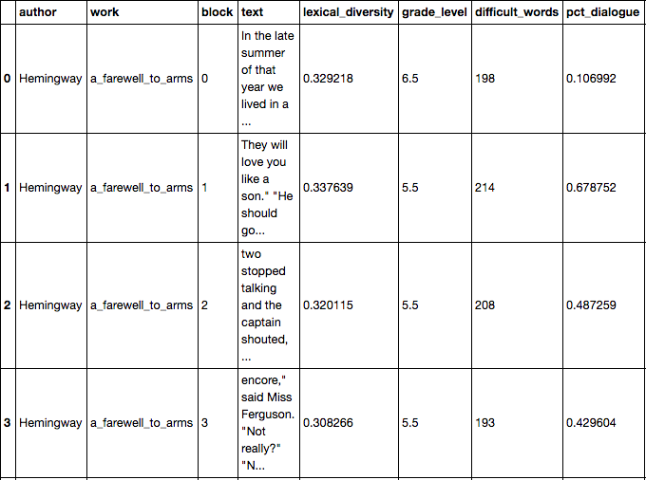
Processing Data
Blocks of 1700 words
Notes:
Started out with raw text for each book: stuff at beginning and end of book, different chapter delineations, different spacing between paragraphs, unreadable characters
Divide into blocks: 1. More observations 2. Allows you to observe variation within a work as well as across an author’s corpus

Slide 4
Final dataset
665 blocks of text, 33 features
Class distribution:
Steinbeck 254
Faulkner 166
Fitzgerald 139
Hemingway 106
Null accuracy rate: 38%

Slide 5
Features
Word level
Length of word
Syllables per word
Year of most common use
Sentence level
Words per sentence
Punctuation use (commas, semicolons, hyphens, etc.)
Block level
Pct. dialogue
Reading difficulty
Lower level features aggregated to block level
Notes:
Avoided using actual words

Slide 6
Scrabble!
Author | Mean Scrabble Score
Fitzgerald | 9.11
Faulkner | 8.54
Steinbeck | 8.15
Hemingway | 8.09

Slide 7
Faulkner vs. Hemingway
“Poor Faulkner. Does he really think big emotions come from big words?”
“He has never been known to use a word that might cause the reader to check with a dictionary to see if it is properly used.”
Metric (75th percentile) | Faulkner | Hemingway
Difficult words / block | 258 | 209
Grade level | 7.5 | 5.5
Total punctuation / sentence | 2.94 | .56

Slide 8
One vs. Rest Classification
Turn response variable (author) into dummies
For each block of text, estimate probability it was written by each author separately
Highest predicted probability wins
Predicted probabilities across authors don’t have to add up to 1
Avoids assumption that authors’ styles are mutually exclusive

Slide 9
Naïve Bayes
Overall accuracy: 76%
Predicted probabilities:
Faulkner blocks: Fitzgerald blocks:
Hemingway blocks: Steinbeck blocks:
Faulkner_prob 0.538855
Fitzgerald_prob 0.023598
Hemingway_prob 0.384323
Steinbeck_prob 0.376416
Faulkner_prob 0.097287
Fitzgerald_prob 0.984562
Hemingway_prob 0.025160
Steinbeck_prob 0.132055
Faulkner_prob 0.018931
Fitzgerald_prob 0.039987
Hemingway_prob 0.953860
Steinbeck_prob 0.898222
Faulkner_prob 5.650974e-07
Fitzgerald_prob 0.1574381
Hemingway_prob 0.8430932
Steinbeck_prob 0.9482283
Notes:
Both Hemingway and Faulkner had particularly bad sensitivity, lower probability on their own works here
ROC > 78 for all, lowest for Hemingway, Fitzgerald at 97

Slide 10
Decision Tree
Overall accuracy: 82%
Important features by author:
Faulkner: Fitzgerald:
Hemingway: Steinbeck:
word_count_std 0.440538
difficult_words 0.172554
hyphens_mean 0.097979
total_punct_mean 0.078675
sentiment 0.047124
hyphens_mean 0.698249
syllable_count_std 0.085571
word_count_mean 0.059230
colons_mean 0.040841
lexical_diversity 0.034442
total_punct_mean 0.497074
most_freq_year_25% 0.100032
length 0.077185
lexical_diversity 0.058059
word_count_max 0.043742
word_count_std 0.383177
total_punct_mean 0.213508
colons_mean 0.072063
difficult_words 0.060956
length 0.045470
Notes:
Probs better than with Bayes: Hemingway troublesome w/ Faulkner and Steinbeck at 16%, Steinbeck gets Fitz at 19% but otherwise no one

Slide 11
Distribution of Important Features

Slide 12
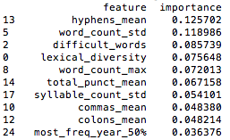
Random Forest
Number of estimators: 150
Max features: 6
OOB Score: 92%
After removing less important features, OOB Score: 91%
Notes:
Reduced impact of individual features, but not apples-to-apples since this was not one vs rest

Slide 13
Conclusions
Results really dependent on choices in data processing/feature extraction
Hyphen/n-dash/m-dash conflation
Choice of block size
Choice of aggregation for word- and sentence-level features
Would be interesting to do more NLP-ey features
Text is incredibly rich…
BUT there’s a lot more to literature than this

Slide 14
The End

